Slide 1
SOCOTECO II Value Chain Analysis
Firm Infrastructure: Decentralized Management of Business Units | Very strong cooperative culture| Very Lean Structure
HR Management : Continues Training Program for Engineers and Non-engineers | Better rewards & healthier Health-care programs | Friendly & cooperative labor relations
Support Activities
Technology Dev. : Integrate Information Systems for faster electric services thru LAN/WAN | GIS (geographic information system)| SCADA (supervisory control and data acquisition)
Procurement : Use e-procurement for cheaper and faster communication with supplier
Design & build TD facilities
Determine total power demand
Buy power from
NPC/NGCP
Distribute to consumers
Bill customers & collect payment for power used
Pay NPC / NGCP
Primary Activities

Slide 2
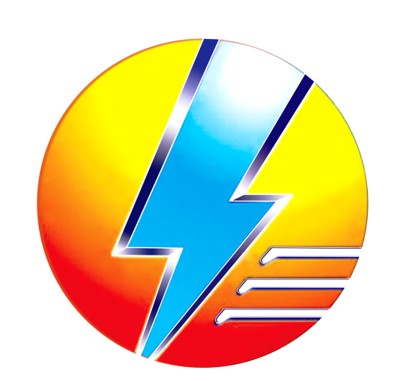
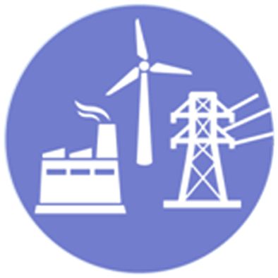

About your electricity supply
Generation & Transmission
Member- Consumers
OUR ROLE
SOCOTECO II is an essential services provider. We own and maintain
the poles, wires, meters and equipment that deliver electricity to you.
WE PROVIDE
A safe and reliable electricity supply. SOCOTECO II is among the most reliable distributors in Region XII.
WE MAINTAIN
The equipment that delivers electricity and the meters at your premises
WE MANAGE
Electricity supply during emergencies and bad weather.
WE RESTORE
Power outage as quickly as possible

Slide 3
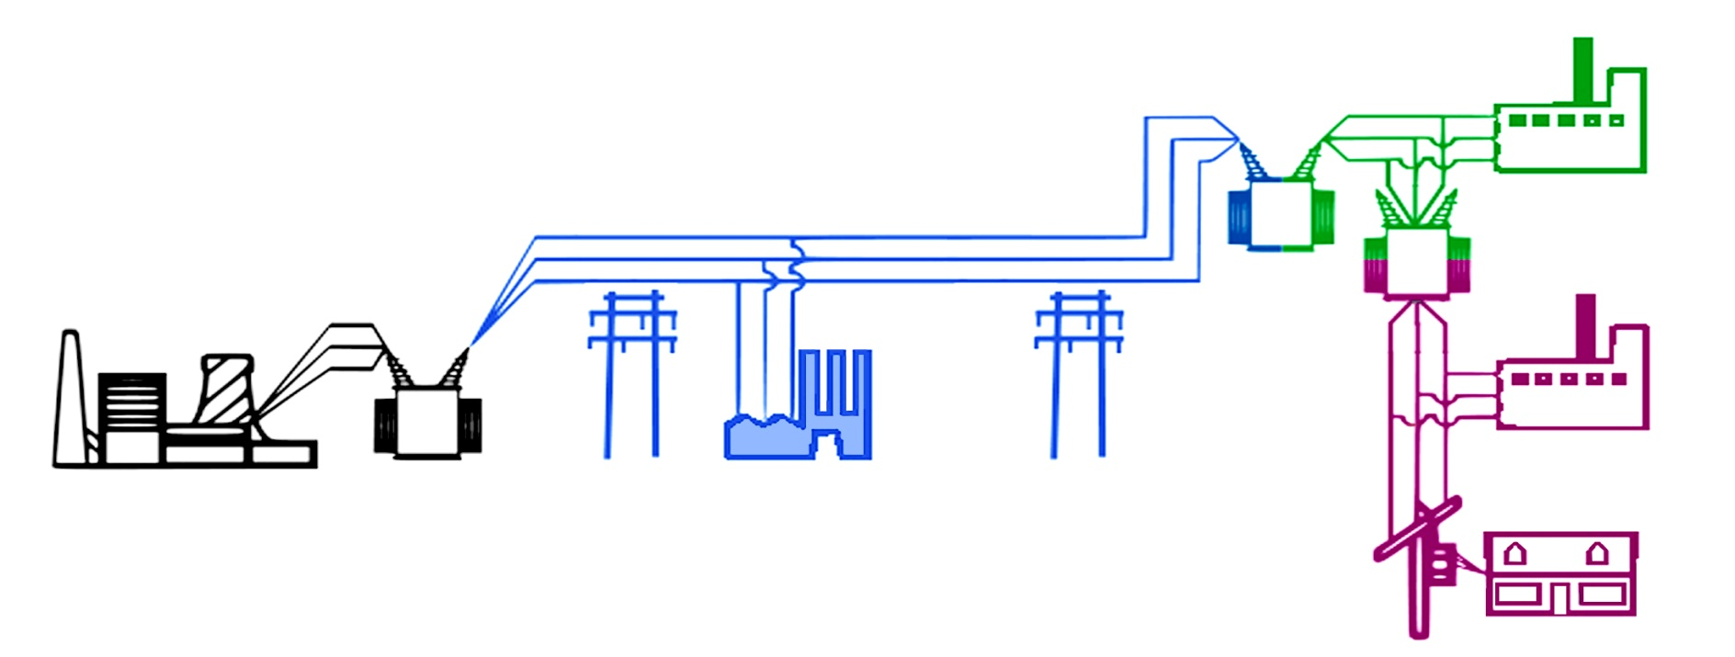
3 Industry Players of the Electric Utility Value Chain
Generation
Transmission
Distribution
Role | Convert fuel energy into electrical energy Increase (‘step up’) voltage for efficient transmission | Transmit electricity over long distances Deliver electricity to large industrial customers | Reduce (‘step down’) voltage Deliver electricity locally to commercial and residential customers
Start and end points | From fuel to the high-voltage output of the generating station | From the high-voltage output of the generating station to the transformer in the substation | From the substation transformer to the customer meter
Generation
Transmission
Distribution
Consumers
Subtransmission-connected customer
34.5 kV, 46 kV, 69 kV
National Grid Corporation of the Philippines (NGCP)
National Power Corporation (PNC)
Generates power And delivered over
the regional power grid.
Distribution
Substation Step-down Transformer
Substation
Step-down
Transformer
Distribution-connected customer
4.2 kV, 12.5 kV, 13.8 kV
Substation
Step-up
Transformer
Transmission-connected customers
Distribution-connected customer
120V & 240V

